Slide 1

Kanvas
Decentralized pixels, unlimited possibilities

Slide 2
Contents
What is Kanvas ?​
What is $KAN ?
User interface
- Game controls
​ - Wallet integration​
- Placing pixels
Community
Interoperability & Collabs
Future vision

Slide 3

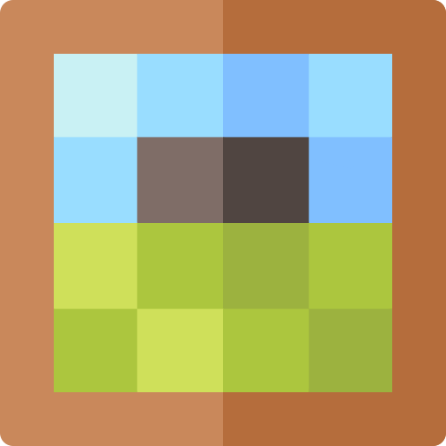
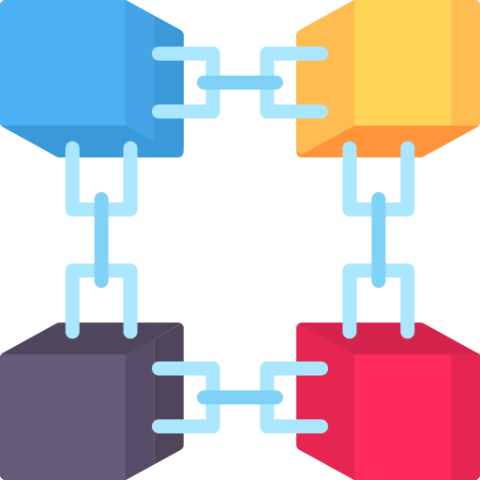
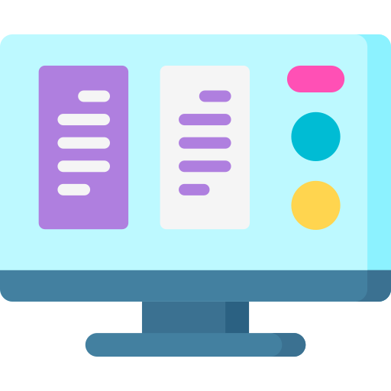
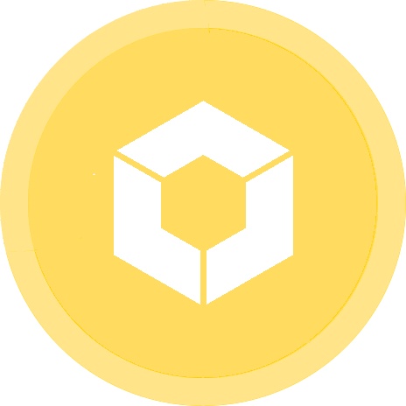
What is Kanvas ?
Origin: Idea back in 2020, but developed by Red Raven in 2023 on Koinos' feeless blockchain for the hackathon
Principle : Modeled after Reddit's viral r/place event, players place colored pixels on a 1000x1000 blank canvas to create drawings, art or advertising !
Decentralization : Pixel map data is stored in a decentralized way using a smart-contract to make this global canvas resilient !
Core mindset : Play a decentralized game as easily as a conventional one, with a clean & functional UI
Backed by a token : $KAN tokens dictate user influence and thus pixel placement capacity : 1 $KAN = 1 pixel placement capacity on the canvas

Slide 4
What is $KAN ?
A token at the heart of the game, representing user capability to place pixels.
$KAN also serves as a project financing, communication & community unification mean
3,000,000 $KAN minted and trading live on KoinDX
Moving $KAN tokens to another account deletes the pixels placed by the old account

Slide 5
The game
How to play ?

Slide 6
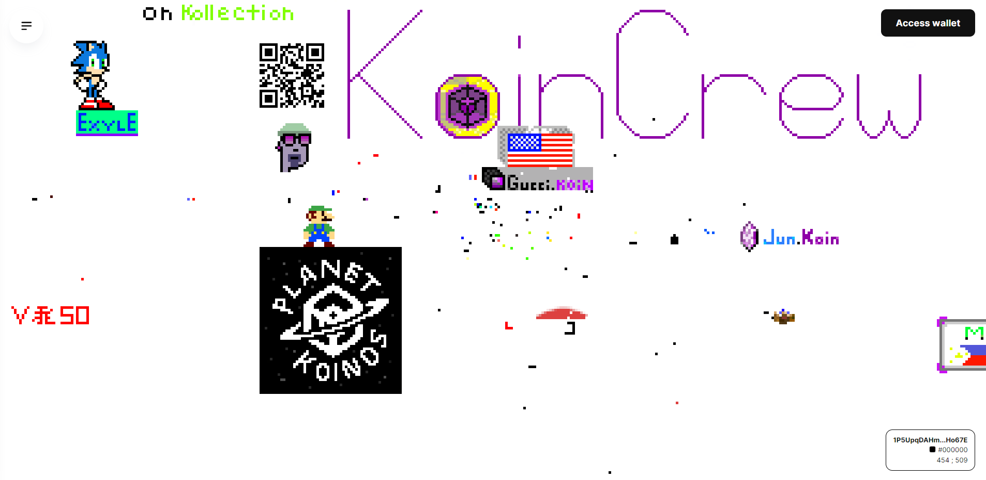
User interface
Embedded wallet
Menu
Hovered pixel info
Drawings on blank canvas

Slide 7
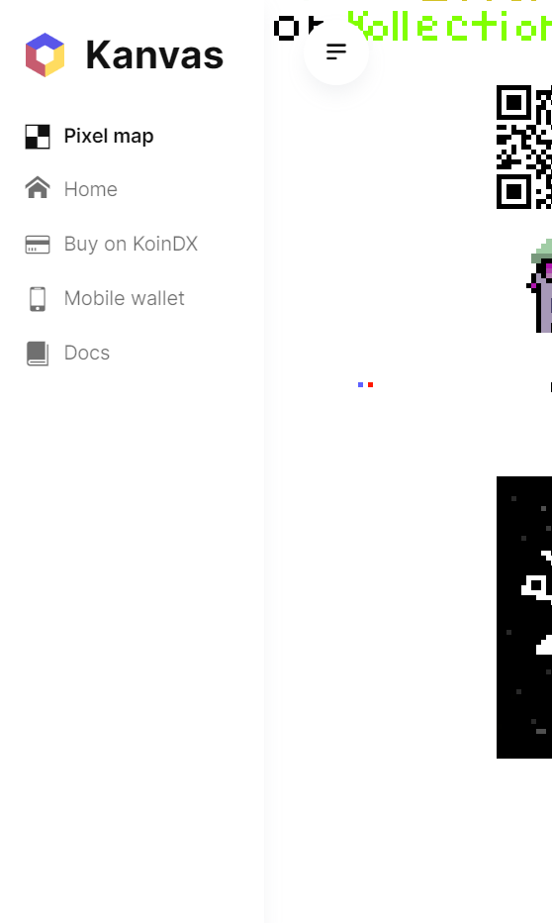
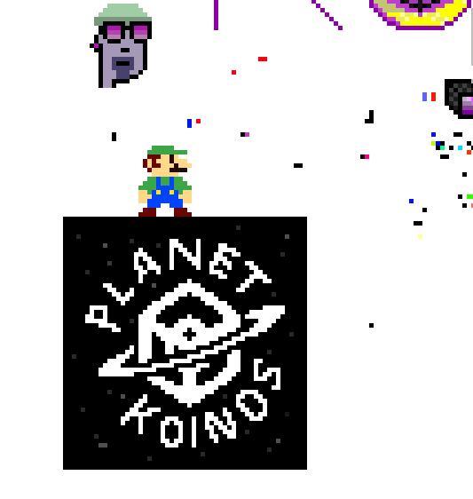
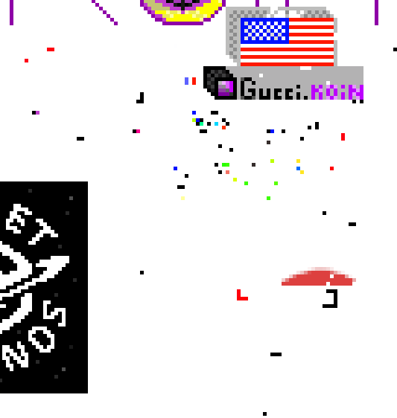

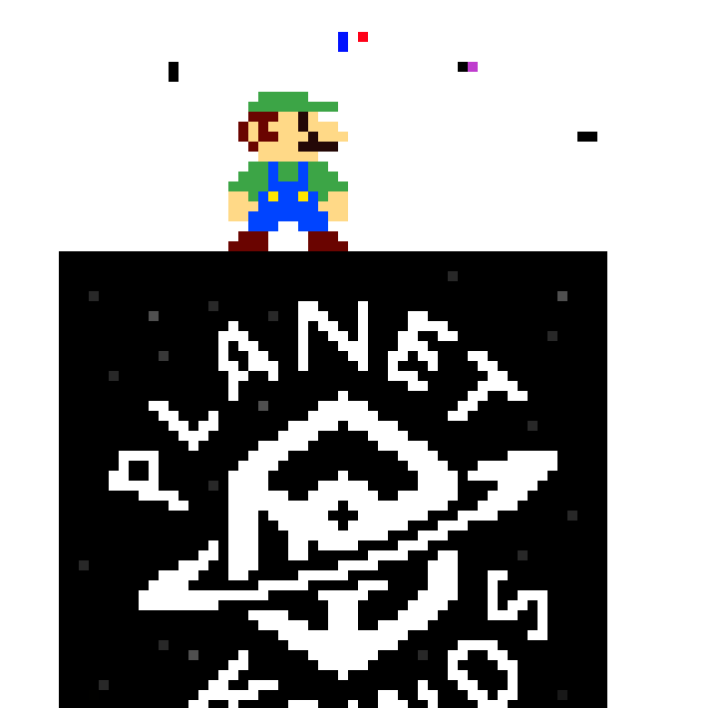

Intuitive CONTROLS
Open menu on click
Move canvas
by cursor dragging
Zoom on canvas
with the mouse wheel
+
-

Slide 8
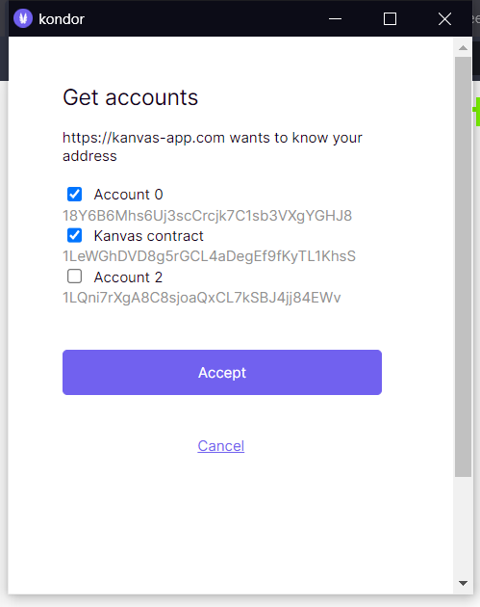
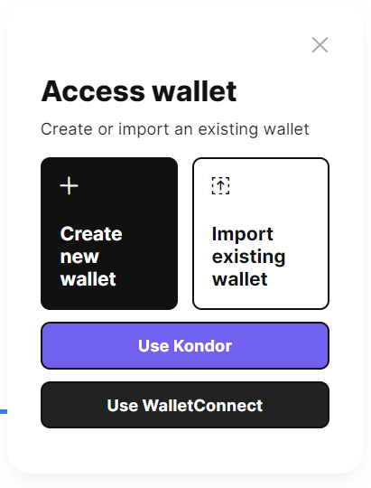
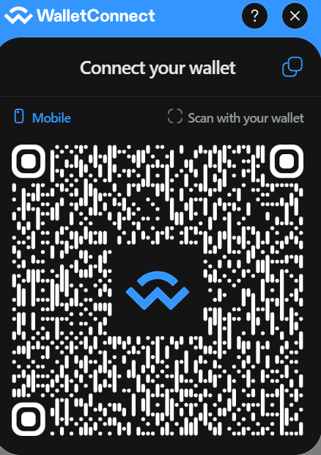
Wallet
1. Access wallet on click
2. Four different wallet options
3.1 Use Kondor to validate transaction on Chrome
3.2 Use WalletConnect to validate transactions on mobile (Konio)

Slide 9
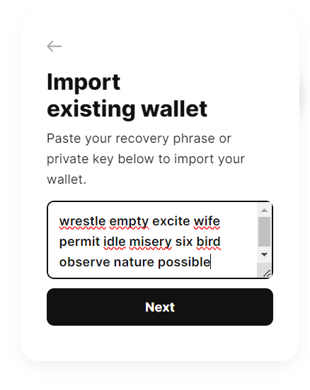
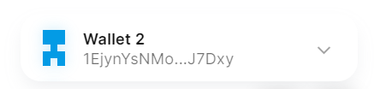
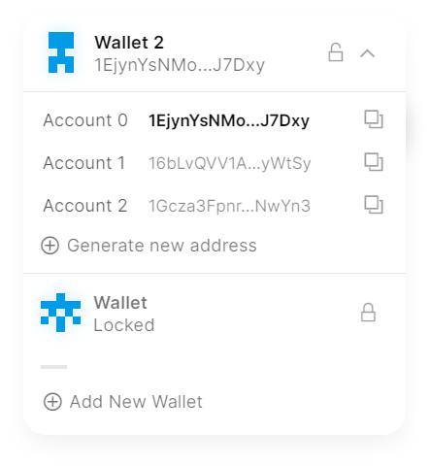
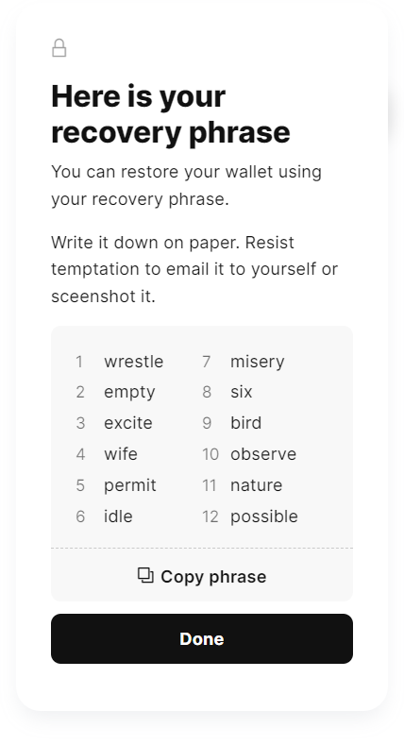
Wallet
Click on the arrow to select your account wallet, with generation button for seeded wallets
Import your wallet with seed or private key (password protected)
Create a new seeded wallet (password protected)
Copy address
Tip : seed is compatible with Kondor and Konio (generating the same accounts)
Unlock another wallet

Slide 10
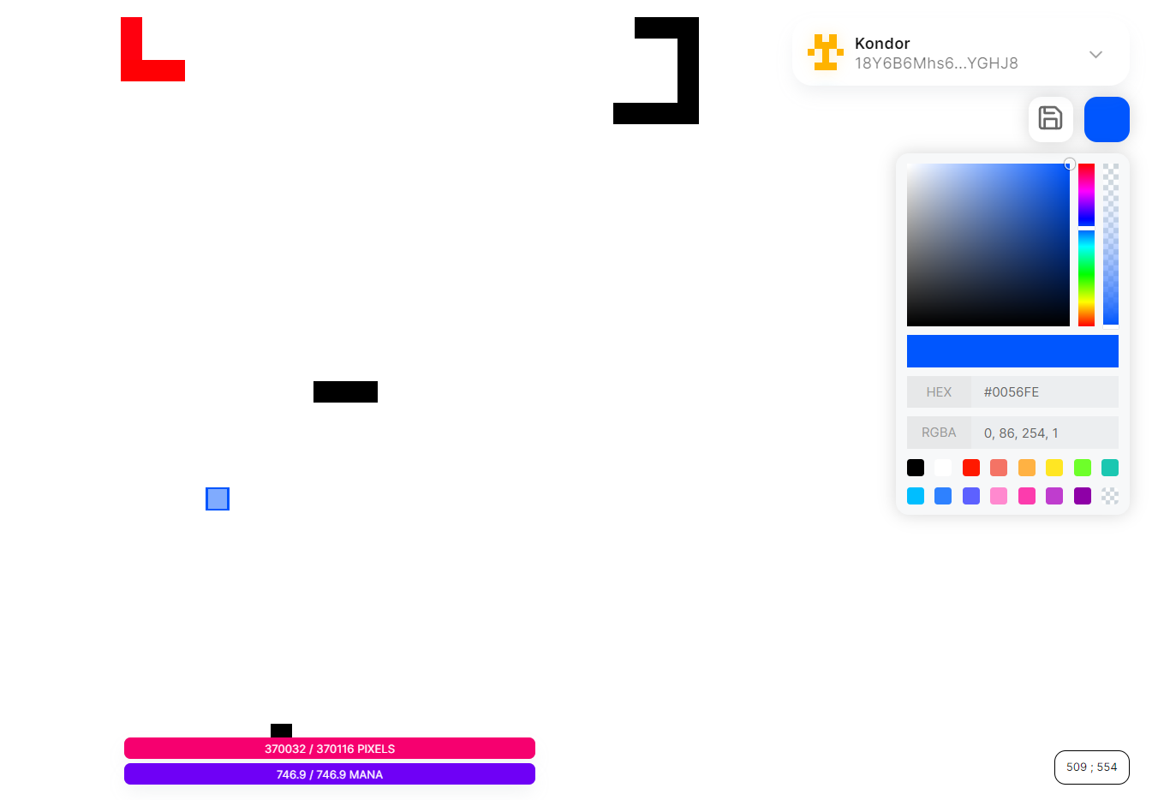
Placing pixels
Click to open color selector
Pixel capacity bar (max = amount of $KAN)
Pixel capacity bar (max = amount of $KAN)
Mana capacity bar (to send transactions)

Slide 11
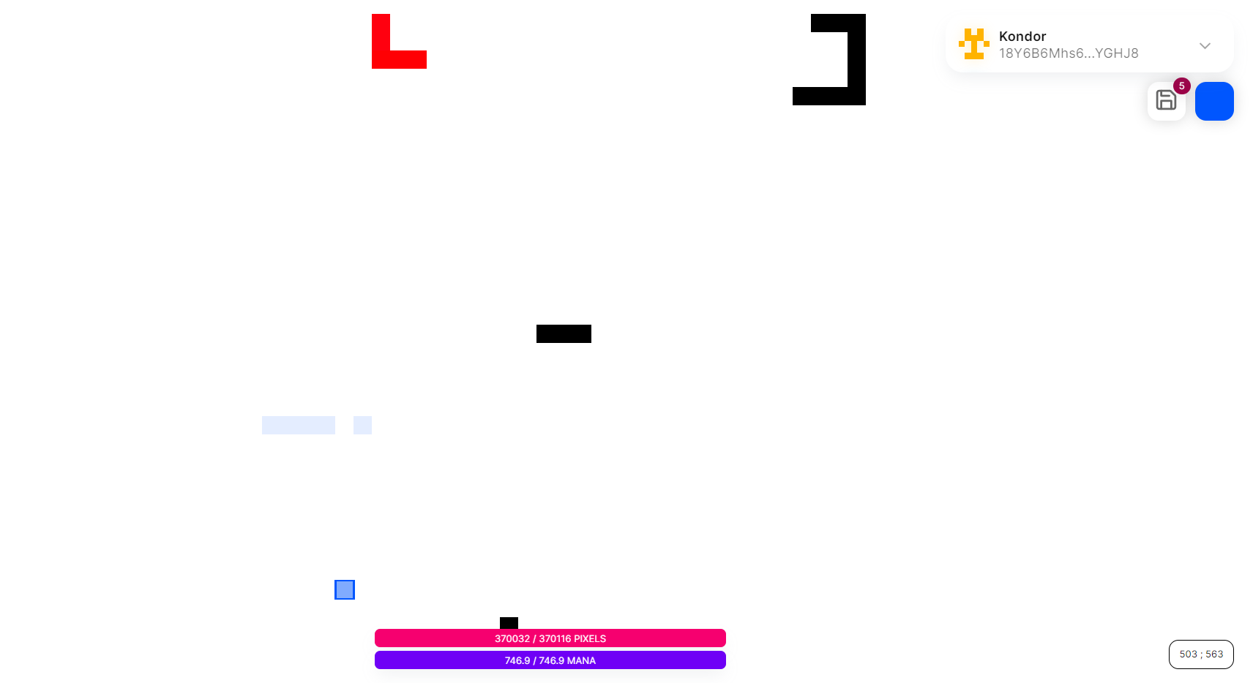
Placing pixels
Number of pixels placed in this transaction (10 max per tx)
Batch of pixels to place will blink
Click on save to send the transaction and save the placed pixels on the blockchain

Slide 12
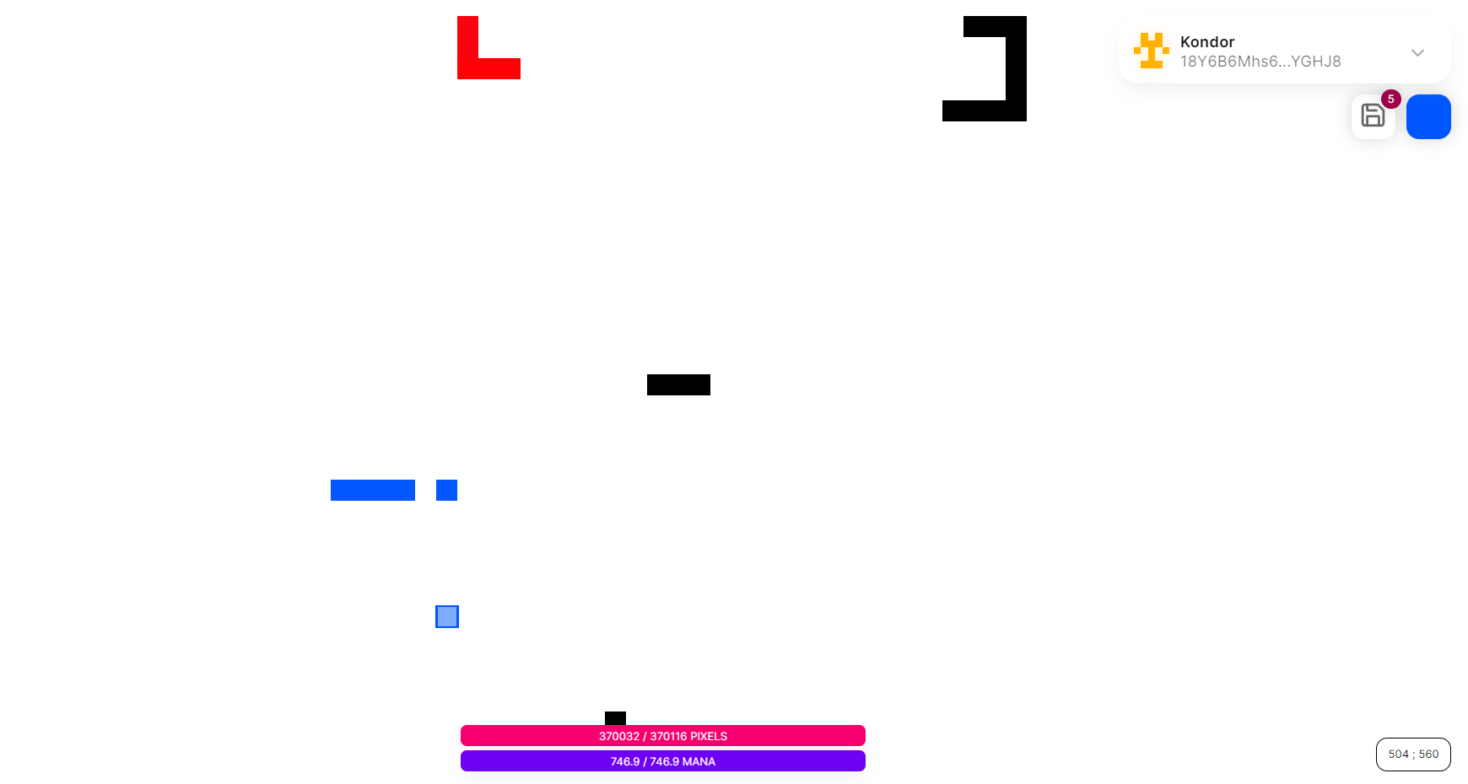
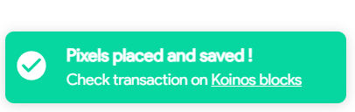
Placing pixels
Pixels are placed !
Pixel capacity is updated accordingly

Slide 13
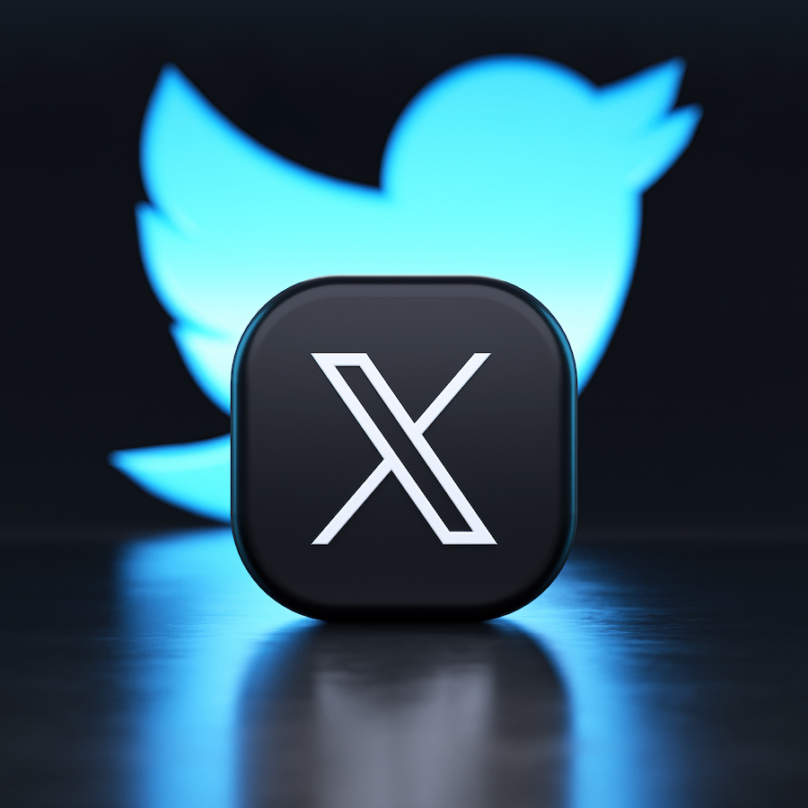


Community
Twitter / X
TELEGRAM
Smart-Contract
200+ followers
25+ group
7300 tx & 40+ $KAN holders

Slide 14





Interoperability & collabs
Koindx
konio
kap
Koin crew
Koinos federation
Officially listed on KoinDX (decentralized exchange on Koinos)
Seamless connexion with our mobile wallet partener, Konio, via WalletConnect
Use of the Koinos Account Protocol to identify the addresses that place the pixels
This important community group of Koinos organizes giveaways on Kanvas.
Kanvas has joined the Koinos Federation, which promotes awareness of the Koinos blockchain, supports the developers and projects.

Slide 15



The road ahead
The money raised by the hackathon will be used to finance the development and marketing of the project, and to keep people motivated. It's a project that has aroused a great deal of interest in the community, and its continuity will be much appreciated. Here's what's planned for the next stage of the project
Development
Marketing
Community
Blank NFT in different sizes for pixel art image stamping
Pixel protection pool (pay more than $KAN for a pixel, but pay more for override)
New drawing tools, including an eraser
Additional information windows
Listing of CoinGecko and Coinmarketcap
Giveaaway via KAP
“Demo” version of the project that don’t save pixels on blockchain
Use mana fountain to power the whole game (users won’t need KOIN anymore)
Artistic contests & partnerships
Security audit for our embedded wallet
Goal of 100 holders for the end of September and 1000 holders for the beginning of next year
CEX listing
Kanvas merchandise

Slide 16
THANK YOU
Visit our official website https://kanvas-app.com & read our docs
Follow us on Twitter join our Telegram group
Buy some $KAN on KoinDX and start playing !

